Slide 1

Interfacing of Bluetooth Module with Arduino Uno and Beaglebone Black
Group 4
Varundeep Singh
C0754247

Slide 2
Contents (Arduino Uno) -
Block Diagram
Hardware and Software used
Introduction of Arduino Uno
Introduction of Bluetooth module
Interfacing and connection of Bluetooth module with Arduino Uno
Output
Hardware circuit

Slide 3
Contents (Beaglebone Black) -
Introduction of Beaglebone Black
Interfacing and connection of Bluetooth module with Beaglebone Black
How to use PSFTP?
Coding in Putty
Output
Hardware circuit
Combined output
Connection of Bluetooth modules
References

Slide 4
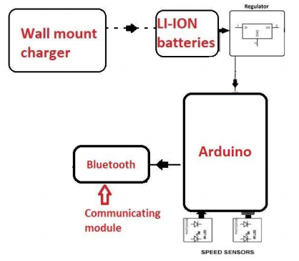
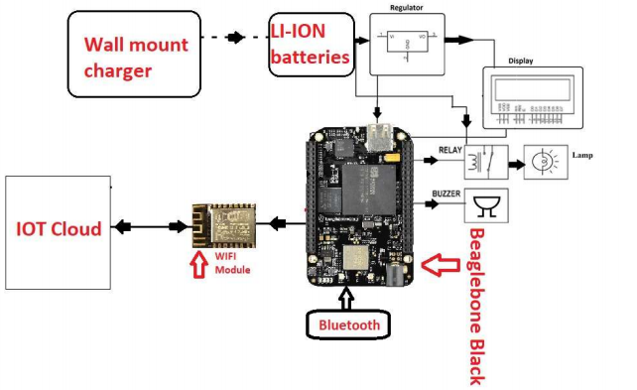
CAR OVER SPEED DETECTION SYSTEM

Slide 5
Hardware and Software used -
Arduino Uno
Beaglebone Black
Connecting wires
Battery
Putty
PSFTP
Arduino IDE
GCC Compiler

Slide 6
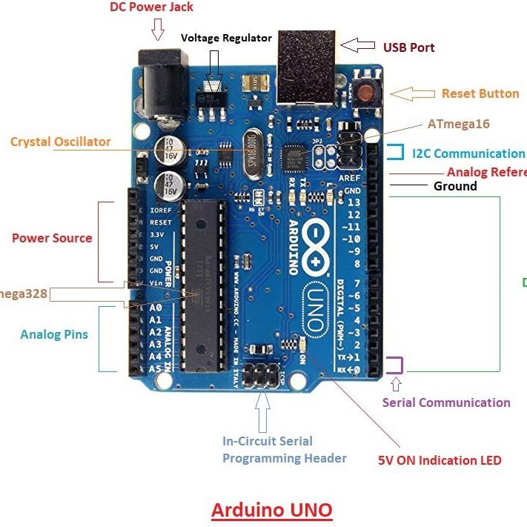
Introduction of Arduino Uno -
Arduino Uno is An open-source microcontroller platform based on Atmega 328.
It requires 6V-12V input power. When the power is less than 6V, it becomes unstable and when the power is more than 12V, it causes heating issues and chances of damaging the board are high.
There are 6 pins for power source.
There are 6 analog pins (A0-A5).
There are 14 input and output pins, out of which 6 pins are used to provide a PWD output.
2 dedicated pins are for I2C protocol.
DC power jack and USB port are also present on the board.

Slide 7
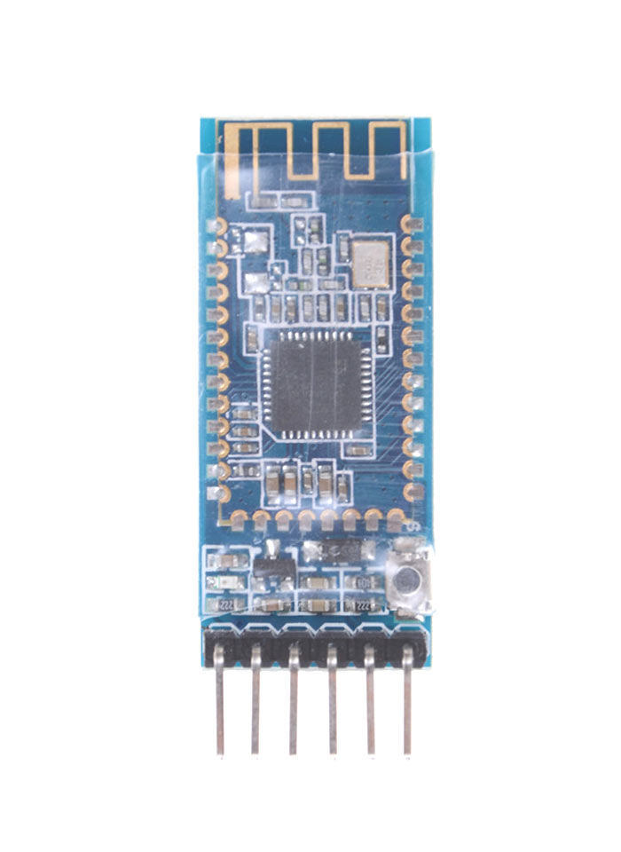
Introduction of Bluetooth Module -
The Bluetooth module that we are using in our project is HM-10.
HM-10 is Bluetooth 4.0 module.
It has a BLE chip (Bluetooth low energy consumption).
UART Serial Interface.
12 GPIO pins.
It can work in long range (approximately 100 meters).
Operating voltage: 2 to 6 V.
Operating temperature: -40 to 85°C

Slide 8
Interfacing and connections -
VCC is connected to +5V power supply.
GND is connected to the ground.
Tx pin is connected to D10 (Rx) pin of the Arduino Uno.
Rx pin is connected to D11 (Tx) pin of the Arduino Uno.

Slide 9
Output -

Slide 10
Hardware circuit -

Slide 11
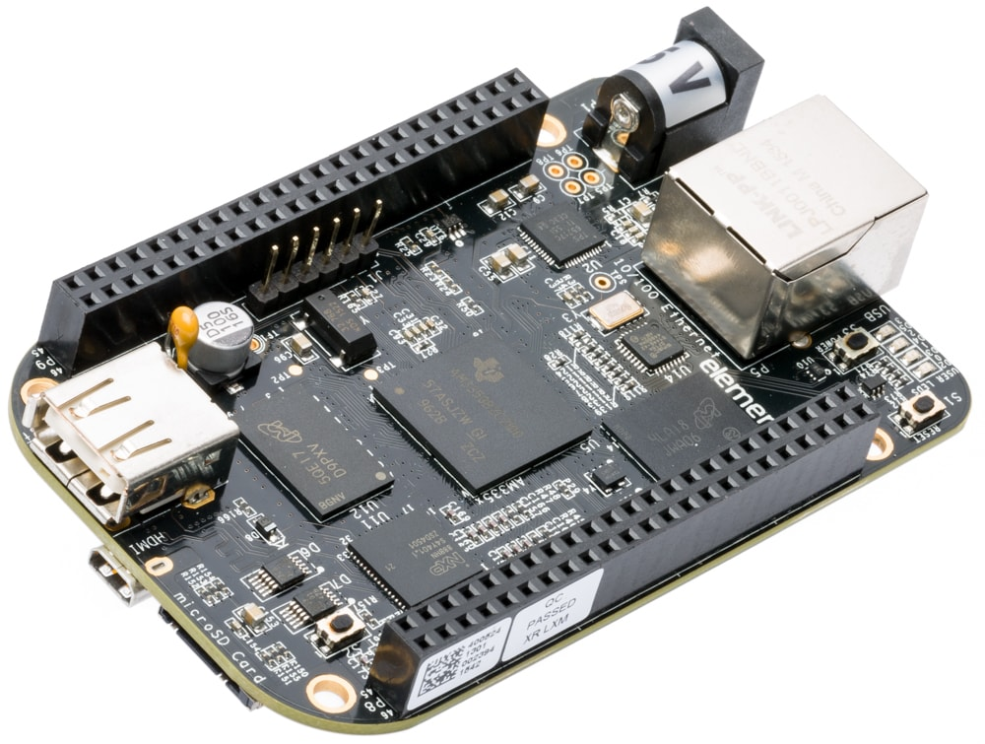
Introduction of Beaglebone Black -
BBB is our main microcontroller unit.
It is a low-cost, community-supported development platform for developers and hobbyists.
Boot Linux in under 10 seconds and get started on development in less than 5 minutes with just a single USB cable.
Processor - AM335x 1GHz ARM Cortex-A8.
512MB DDR3 RAM.
4GB 8-bit eMMC on-board flash storage.
3D graphics accelerator.
NEON floating-point accelerator.
2x PRU 32-bit microcontrollers.

Slide 12
Interfacing and connections -
VCC is connected to +5V power supply.
GND is connected to the ground.
Tx pin is connected to P9.11 (UART4_RXD) pin of the Beaglebone Black.
Rx pin is connected to P9.13 (UART4_TXD) pin of the Beaglebone Black.

Slide 13
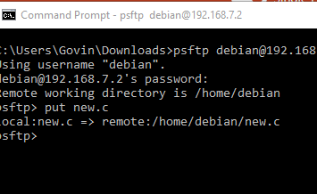
HOW TO USE PSFTP?
Here, I am going to say how we can transfer files from our host machine to remote system such as Beaglebone Black.
WinSCP is also an open source sftp client for secure transfer of files, but here I like to say how we can transfer files using psftp which is similar to sftp in Linux.
Download psftp.exe file and open command prompt then change the directory in which it contains program file.
Use command psftp debian@192.168.7.2 and password as"temppwd" to enter into psftp interface and use put "filename" to transfer file.

Slide 14
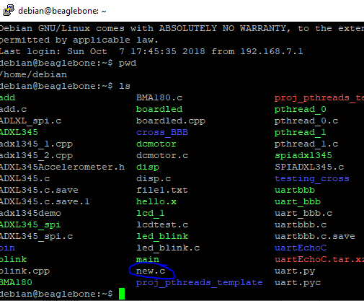
CONT..
Before using psftp open putty and log into Beaglebone using its IP address, username and password.
Use ls command to see all the files.
After using put "filename" command in psftp.exe we can see the file inside Beaglebone Black.

Slide 15
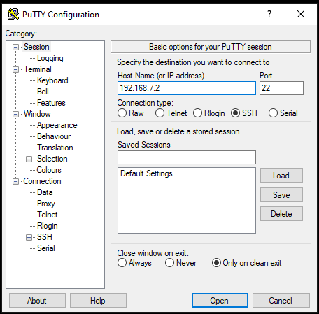
Coding in Putty -
This is the Putty configuration page (starting page).
We have to enter the IP address of our Beaglebone Black.
IP address is 192.168.7.2
Then click on open.

Slide 16
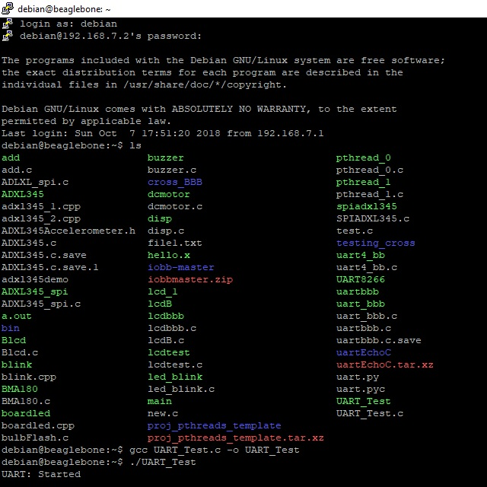
Coding in Putty (Contd…) -
We have to enter Debian as login and password as temppwd.
The next command is “ls” to see all the files.
Our file is BLE_BB.c
To open the file, we used command “nano BLE_BB.c”
Next command is “gcc BLE_BB.c o BLE_BB” to compline the program.
“./ BLE_BB.c” to run the file.

Slide 17
Output -

Slide 18
Hardware circuit -

Slide 19
Combined Output -

Slide 20
Connection of Bluetooth modules -
Set the second module to be the slave device (the default setting).
Set the main module to manual start mode using “AT+IMME1”.
Then set the main module to be the master device with “AT+ROLE1”.
Then use “AT+CON” to connect. Of course you need to know the address of the second module which can be found using “AT+DISC?”.
Now we have the address of the second HM-10 we can connect using the address or the list index. You would need to change the address to suit the modules you are using.
If the connection is successful we get “OK+CONNA” and the LEDs on the HM-10s stop flashing and become steady on.

Slide 21
References -
Arduino Uno. (2018, February 28). Retrieved from https://components101.com/microcontrollers/arduino-uno
HM-10 Bluetooth Module (2018, September 25). Retrieved from https://components101.com/wireless/hm-10-bluetooth-module
Pandit, A. (2019, June 10). How to use HM-10 BLE Module with Arduino to control an LED using Android app. Retrieved from https://circuitdigest.com/microcontroller-projects/how-to-use-arduino-and-hm-10-ble-module-to-control-led-with-android-app
HM-10 Bluetooth 4 BLE Modules. (2017, January 5). Retrieved from http://www.martyncurrey.com/hm-10-bluetooth-4ble-modules/#:~:text=The%20HM%2D10%20is%20Bluetooth,over%20the%20serial%20UART%20connection
Beaglebone Black. (2018, July 9). Retrieved from https://components101.com/microcontrollers/beaglebone-black-pinout-datasheet

